Slide 1
PDU Ethernet Board (STM32MP1) Schematic
TK05 Andrew

Slide 2
Outline
Functional block diagram
MCU-STM32MP151C
DDR3L-WinBond W634GU6NB
PHY IC-Realtek RTL8211-FI
Power Management IC-STPMIC1
NAND FLASH-Micron MT29F8G08ABACAH4-IT
Pin header definition
Verification strategy

Slide 3
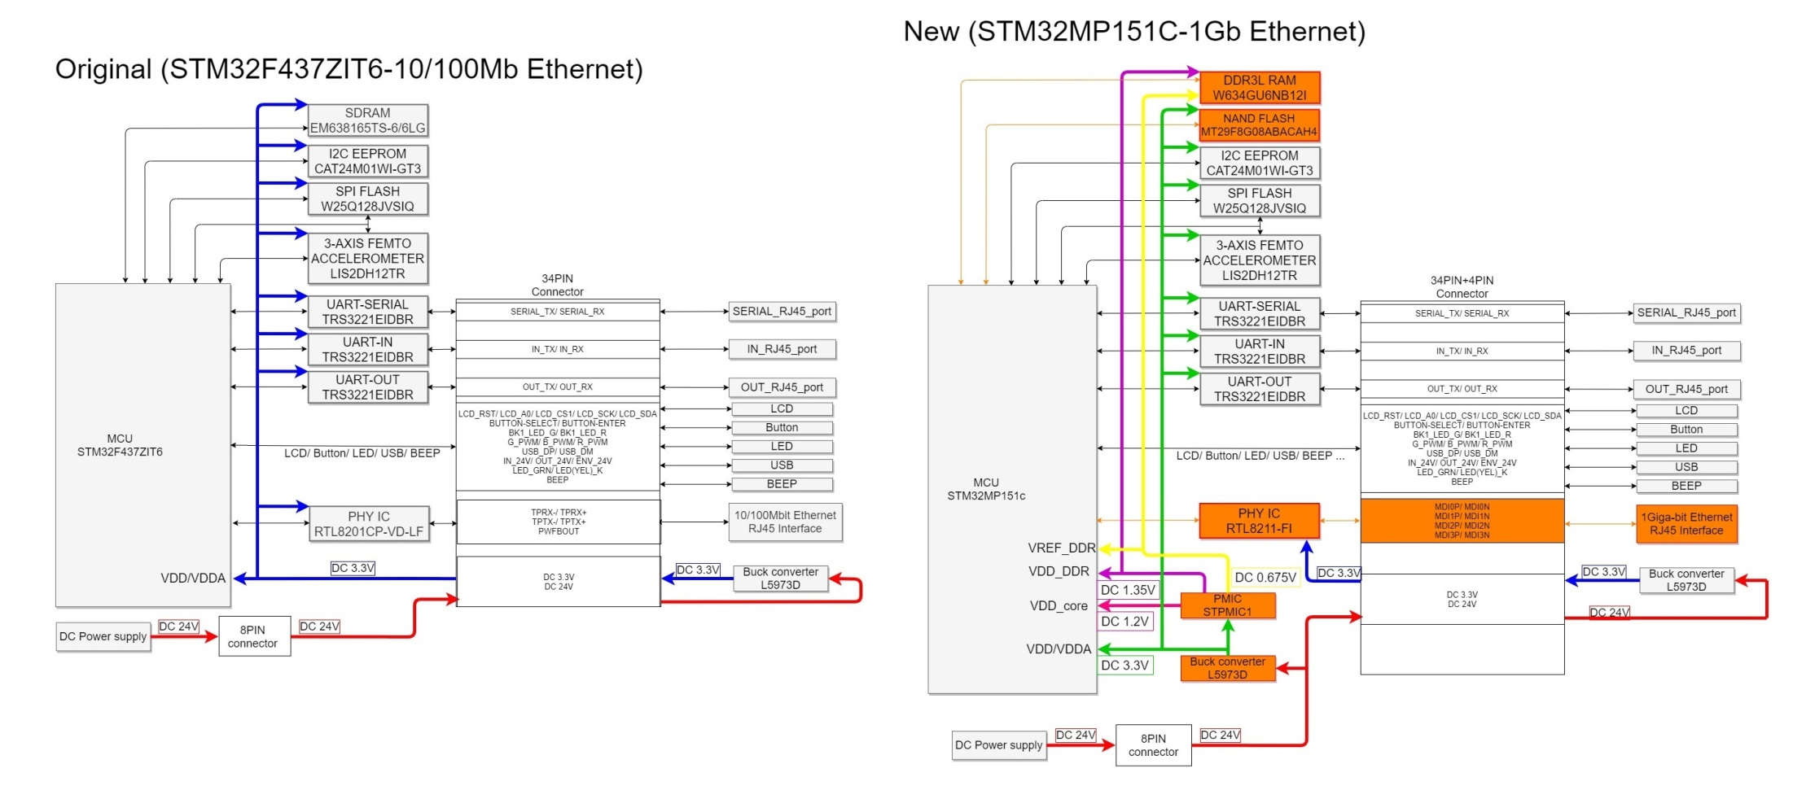
Function block diagram
STM32F437 vs. STM32MP151C

Slide 4
MCU-STM32MP151C
Features
32-bit Arm® Cortex®-A7 650 MHz
32-bit Arm® Cortex®-M4 with FPU/MPU Up to 209 MHz
External DDR memory up to 1 Gbyte LPDDR2/LPDDR3/DDR3/DDR3L-1066 16/32-bit
Internal oscillators: 64 MHz HSI oscillator, 4 MHz CSI oscillator, 32 kHz LSI oscillator
External oscillators: 8-48 MHz HSE oscillator, 32.768 kHz LSE oscillator
2 × USB 2.0 high-speed Host + 1 × USB 2.0 full-speed OTG or 1× USB 2.0 high-speed Host + 1 × USB 2.0 high-speed OTG
10/100M or Gigabit Ethernet GMAC – IEEE 1588v2 hardware, MII/RMII/GMII/RGMII

Slide 5
MCU-STM32MP151C
Power supply scheme
VDD - the main supply for I/Os. Useful voltage range is 1.71 V to 3.6 V (e.g. 1.8 V, 2.5 V, 3.0 V or 3.3 V typ.)
VDDA - the analog (ADC/DAC/VREF), supply voltage range is 1.71 V to 3.6 V.
VDDCORE - the main digital voltage and is usually shutdown during Standby mode. Voltage range is 1.18 V to 1.25 V (1.2 V typ.)
VDDQ_DDR - the DDR IO supply.
Voltage range is 1.425 V to 1.575 V for DDR3 memories (1.5 V typ.)
Voltage range is 1.283 V to 1.45 V for DDR3L memories (1.35 V typ.)
Voltage range is 1.14 V to 1.3 V for LPDDR2 or LPDDR3 memories (1.2 V typ.).
Maximum current for VDD/VDDA：440mA
Maximum current for VDDCORE：1500mA

Slide 6
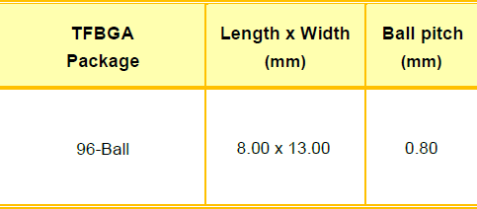
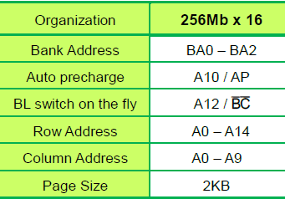
DDR3L-WinBond W634GU6NB
Features
32M x 8 BANKS x 16 Bit = 512MByte
For 32 bit bandwidth, 2 pcs 16bit-DDR3L are required
Power Supply: VDD, VDDQ = 1.283V to 1.45V (1.35V typ.) Imax = 295mA @ Operating Bank Interleave w/ DDR3L-1333

Slide 7
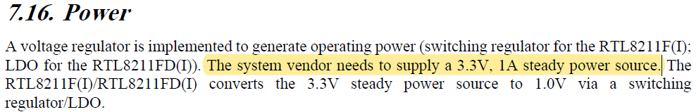
PHY IC-Realtek RTL8211-FI
Features
1000Base-T IEEE 802.3ab Compliant
100Base-TX IEEE 802.3u Compliant
10Base-T IEEE 802.3 Compliant
Supports RGMII
Supports 25MHz external crystal or OSC
Provides 125MHz clock source for MAC
Power supply：

Slide 8
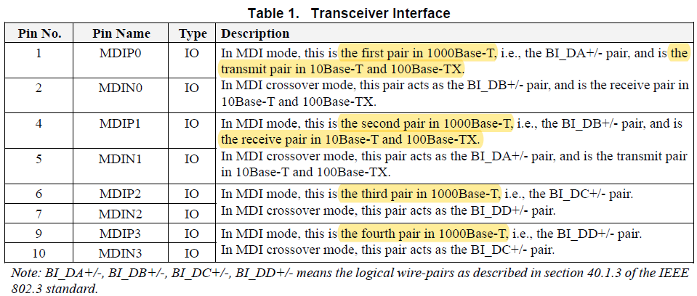
PHY IC-Realtek RTL8211-FI
Transceiver Interface

Slide 9
Maximum power consumption
Maximum Power consumption
MCU- ST STM32MP151C
VDD/VDDA：3.3Vx440mA=1.452W
VDDCORE ：1.2Vx1500mA=1.8W
DDR3L- WinBond W634GU6NB x2 (For 32-bit bandwidth)
VDDQ_DDR：1.35Vx590mA=0.797W
PHY IC- Realtek RTL8211-FI
VDD：3.3Vx1000mA=3.3W (Not continuous)
Maximum power consumption：7.35W

Slide 10
Power consumption
Measure STM32MP157C-EV1
Scene. | With Gb-Ethernet | With LCD | Vrms (V) | Irms (A) | Prms (W) | Pmax (W)
A | No | Yes | 5.15 | 0.532 | 2.7557 | N/A
B | No | No | 5.1996 | 0.245 | 1.2958 | N/A
C | Yes | Yes | 5.0511 | 0.691 | 3.468 | 4.11
D | Yes | No | 5.1 | 0.408 | 2.078 | 2.6
 | LCD about: |  |  | A-B | 1.4599
 |  |  |  | C-D | 1.39
 | Gb-Ethernet About: |  |  | C-A | 0.7123
 |  |  |  | D-B | 0.7822
 | *Measure on 5V Input (before STPMIC1)

Slide 11
Power supplies scheme
Structure
2 Buck ICs ST-L5973D for 12V/24V to +3.3V and 5V on LCD board for
+3.3V for LCD/ LED/ BUTTON (LCD board)
+3.3V for PHY IC RTL-8211-FI (Ethernet board)
5V for USB (LCD board)
1 Buck IC ST-L5973D for 12V/24V to +3V3 on Ethernet board for
MCU ST32MP151C
NAND FLASH/ SPI FLASH/ I2C/ UART/ ACCELEROMETER
PMIC STPMIC1
1 PMIC-STPMIC1 for +3V3 to 1.35V/ 1.2V/ 0.675V on Ethernet board for
1.2V for MCU ST32MP151C
1.35V for DDR3L
0.675V for DDR3L/ MCU ST32MP151C

Slide 12
Power Management IC-STPMIC1
Features
Input voltage range from 2.8 V to 5.5 V
7xLDOs+4xBUCK+1xBOOST
BUCK1：For VDDCORE-1.2V (STM32MP151C) @ 2A
BUCK2：For VDD_DDR-1.35V (DDR3L) @ 1A
LDO3：For VTT_DDR3-BUCK2/2 (DDR3L) @ ±200mA
LDO Vref_DDR：VREF_DDR-BUCK2/2 (DDR3L) @ ±25mA

Slide 13
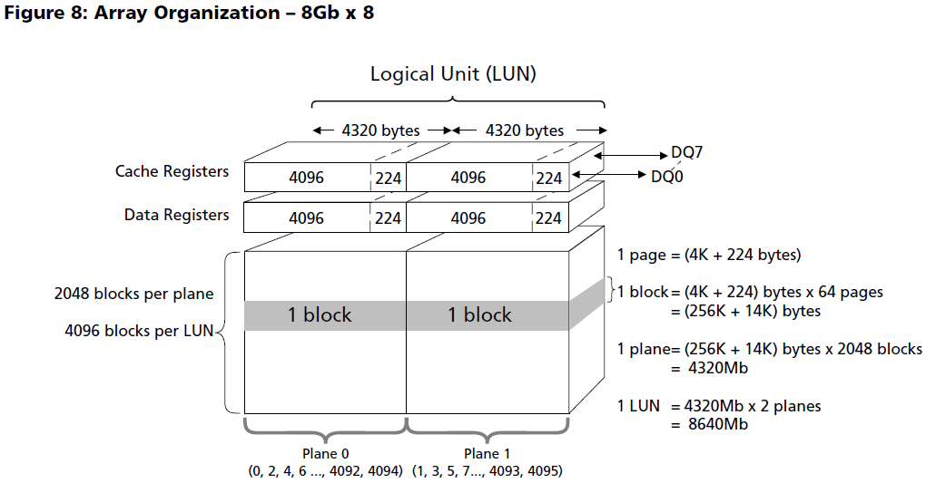
NAND FLASH-Micron MT29F8G08ABACAH4-IT
Features
Operating voltage range – VCC: 2.7–3.6V (3.3V typ. @ 35mA)
Page size x8: 4320 bytes (4096 + 224 bytes)
Block size: 64 pages (256K + 14K bytes)
Plane size: 2 planes x 2048 blocks per plane
Device size: 8Gb: 4096 blocks

Slide 14
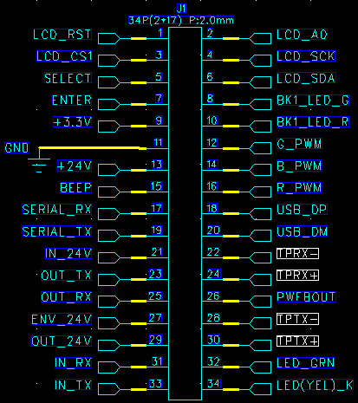
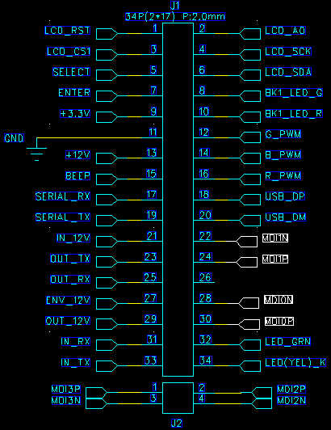
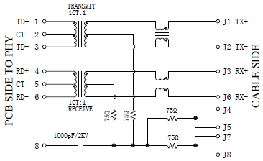
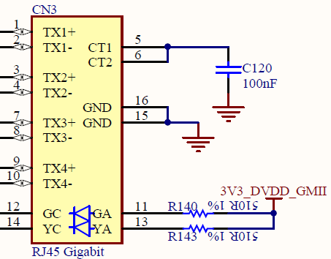
Pin header definition
The original vs. current

Slide 15
Verification strategy
W/ PDU41001 LCD board
Measure each voltage- 3.3V/ 1.35V/ 1.2V/ 0.675V
Confirm the power sequences meet spec or not
Confirm the crystal output meets PHY IC spec or not
Confirm display interface (LCD, LED… )
Confirm communication interface (USB, UARTs, SPI-LCD… )
Confirm internal drivers (I2C EEPROM, SPI Flash, SPI ACCEMETER… )
Confirm 10/100Mb Ethernet is compliant or not
Confirm 1Gb Ethernet via jumpers

Slide 16
Thank You!

